Slide 1
Modeling Genome Data Using Bidirectional LSTM
Neda Tavakoli
Computer Science
Georgia Institute of Technology
July 15, 2019

Slide 2
In this talk...
Motivation
Sequence Alignment
Alignment Score
Locality Sensitive Hashing (LSH)
Recurrent Neural Network
Long Short-term Memory (LSTM)
Bidirectional LSTM
LSH-Based Sequence Alignment Using LSTM
Learning algorithm
Trained LSH
Experimental Results
Conclusion and Future work

Slide 3
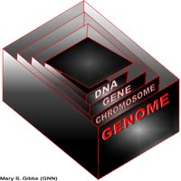
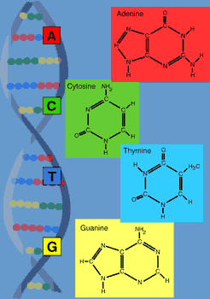
Motivation
Genome: is divided into chromosomes, chromosomes contain genes, and genes are made of DNA.
A genome is simply the sum total of an organism's DNA.
A gene consists of enough DNA to code for one protein.
Genome data is very large (~3 Billion for human genome)
Modeling Genome sequence helps to label which part of DNA corresponds to protein.
Using LSTM to model Gnome data helps to achieve this goal efficiently.
Notes:
http://www.genomenewsnetwork.org/resources/whats_a_genome/Chp1_4_1.shtml
A genome is an organism’s complete set of DNA, including all of its genes. Each genome contains all of the information needed to build and maintain that organism. In humans, a copy of the entire genome—more than 3 billion DNA base pairs—is contained in all cells that have a nucleus.

Slide 4
Motivation
Model human genome using a bidirectional LSTM to obtain a LSH (locality-sensitive hashing).
Using the LSH to perform sequence alignment ( for example to match a given protein to a genome).
Evaluate the sequence alignment score.
Background: Sequence Alignment, Alignment score, LSH
RNN, LSTM, bidirectional LSTM.

Slide 5
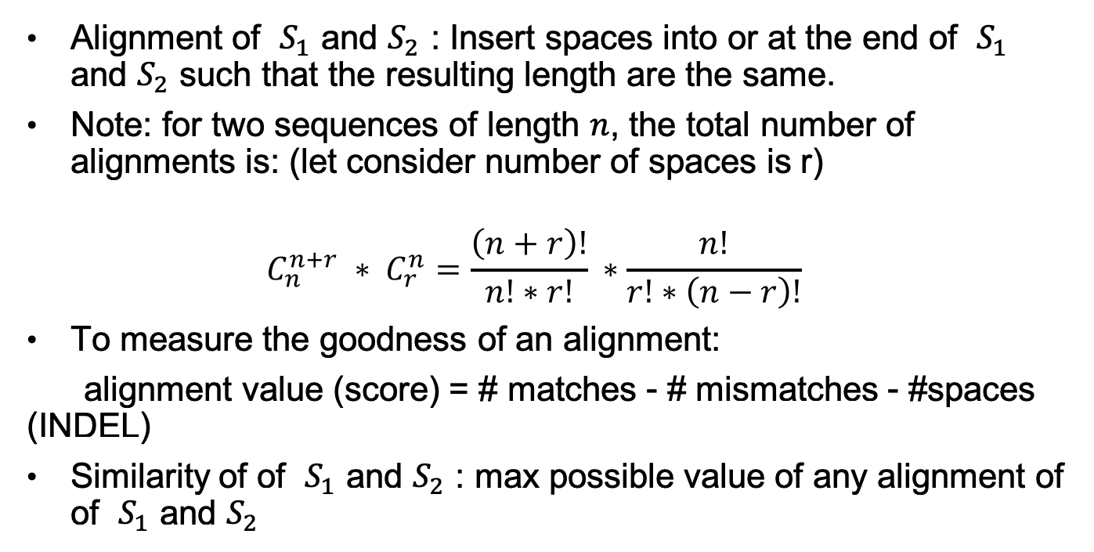
Sequence Alignment
Alignment of $S_{1}$ and $S_{2}$ : Insert spaces into or at the end of $S_{1}$ and $S_{2}$ such that the resulting length are the same.
Note: for two sequences of length $n$, the total number of alignments is: (let consider number of spaces is r)
$$C_{n}^{n+r} ∗ C_{r}^{n}=\frac{\left(n+r\right)!}{n!∗r!} ∗\frac{n!}{r!∗\left(n−r\right)!}$$
To measure the goodness of an alignment:
alignment value (score) = # matches - # mismatches - #spaces (INDEL)
Similarity of of $S_{1}$ and $S_{2}$ : max possible value of any alignment of of $S_{1}$ and $S_{2}$
Notes:
Sequence alignment is an approach to represent the relationship between two sequences. Particularly, it arranges the sequences to identify regions of similarity among them.
Briefly, to align two sequences together, a place of each symbol will be adjusted as follows:
Inserting some number of blanks in front of one sequence.
Inserting some number of ”-” symbol (a symbol which is not in the alphabet, and is also called gap) at some point in the sequence.
Alignment Score:
To measure the quality of an alignment for a given query sequence, the alignment score is defined as the summation of the symbol-wise score symbols, and the gap penalty.

Slide 6
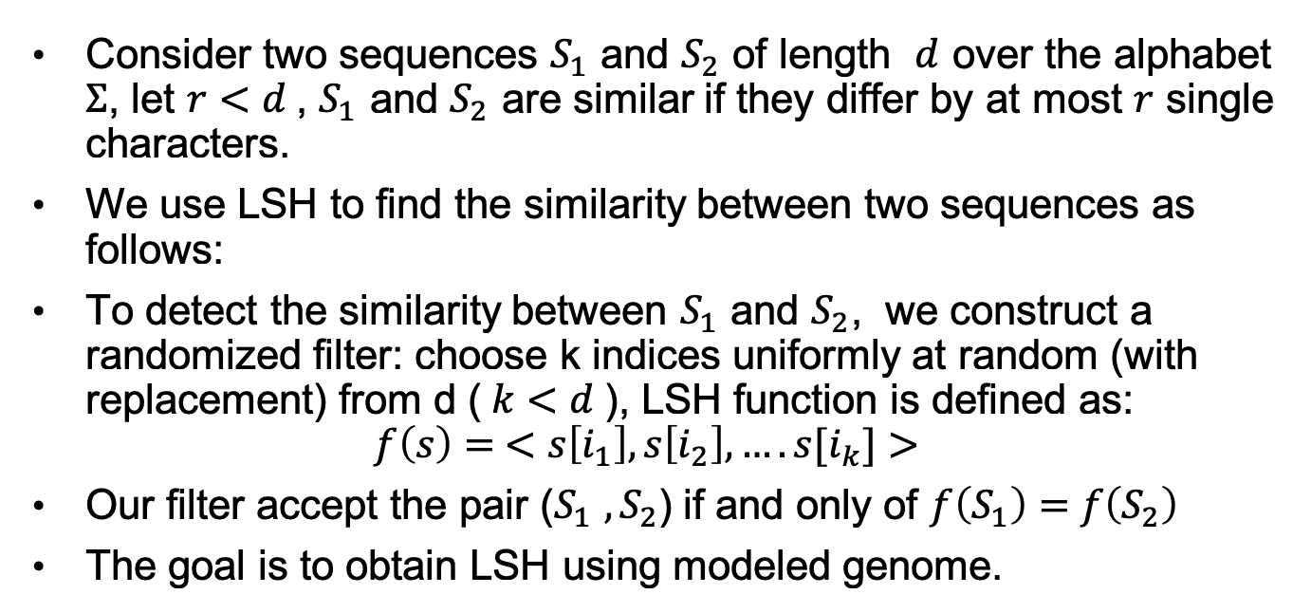
Locality Sensitive Hashing (LSH)
Consider two sequences $S_{1}$ and $S_{2}$ of length $d$ over the alphabet $Σ$, let $r<d$, $S_{1}$ and $S_{2}$ are similar if they differ by at most $r$ single characters.
We use LSH to find the similarity between two sequences as follows:
To detect the similarity between $S_{1}$ and $S_{2}$, we construct a randomized filter: choose k indices uniformly at random (with replacement) from d ($k<d$), LSH function is defined as:
$$f\left(s\right)= <s\left[i_{1}\right], s\left[i_{2}\right], ….s[i_{k}]>$$
Our filter accept the pair ($S_{1} ,S_{2}$) if and only of $f\left(S_{1}\right)=$ $f\left(S_{2}\right)$
The goal is to obtain LSH using modeled genome.
Notes:
Locality-Sensitive Hashing (LSH) is a family of functions, F, used to hash data items into “buckets” such that similar items are more likely mapped to the same buckets .
If data items are far from each other they are likely mapped onto different buckets.
The major difference between LSH and traditional hashing methods is about the ability of LSH to maximize the probability of collision for similar items.

Slide 7
Recurrent Neural Network (RNN)
Regular neural network
RNN
Notes:
In conventional neural networks, all inputs (and outputs) are independent of each other and thus the underlying learning algorithm does not maintain the previous inputs in order to predict the outputs.
On the other hand, RNNs make use of sequential information (i.e., previous inputs) by providing a memory gate and thus keep the previous inputs that have been received.
Y is a probability distribution over the next element of the sequence while taking into consideration the current input and also what it has been learned from the inputs the model received previously.

Slide 8
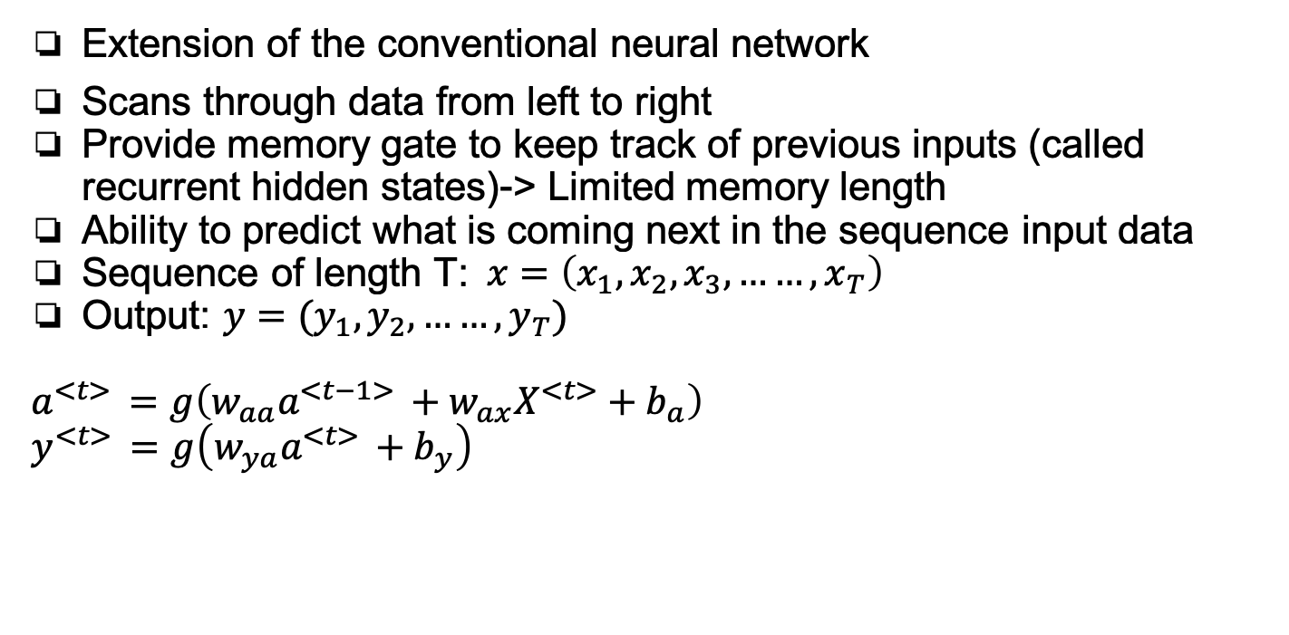
Recurrent Neural Network (RNN)
Extension of the conventional neural network
Scans through data from left to right
Provide memory gate to keep track of previous inputs (called recurrent hidden states)-> Limited memory length
Ability to predict what is coming next in the sequence input data
Sequence of length T:$x=\left(x_{1},x_{2},x_{3},……,x_{T}\right)$
Output: $y=(y_{1},y_{2},……,y_{T})$
$$a^{<t> }=g\left(w_{aa}a^{<t−1> }+w_{ax}X^{<t>}+b_{a}\right)$$
$$y^{<t> }=g\left(w_{ya}a^{<t> }+b_{y}\right)$$
Notes:
In conventional neural networks, all inputs (and outputs) are independent of each other and thus the underlying learning algorithm does not maintain the previous inputs in order to predict the outputs.
On the other hand, RNNs make use of sequential information (i.e., previous inputs) by providing a memory gate and thus keep the previous inputs that have been received.
Y is a probability distribution over the next element of the sequence while taking into consideration the current input and also what it has been learned from the inputs the model received previously.
In conventional neural networks, all inputs (and outputs) are independent of each other and thus the underlying learning algorithm does not maintain the previous inputs in order to predict the outputs.
On the other hand, RNNs make use of sequential information (i.e., previous inputs) by providing a memory gate and thus keep the previous inputs that have been received.

Slide 9
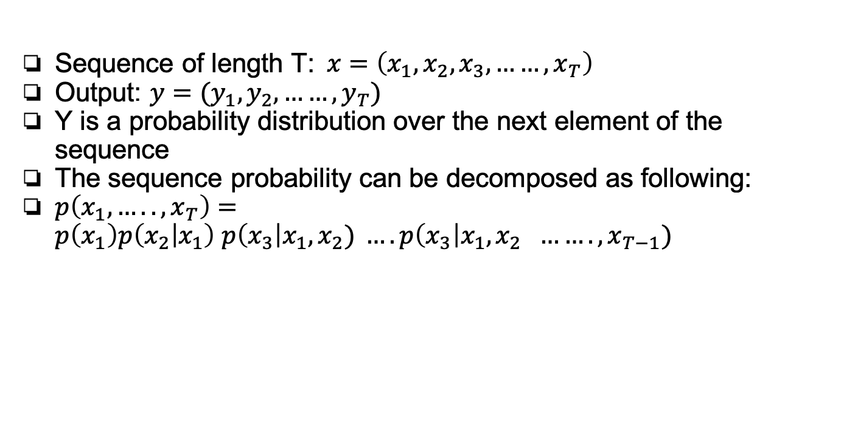
Recurrent Neural Network (RNN)
Sequence of length T:$x=\left(x_{1},x_{2},x_{3},……,x_{T}\right)$
Output: $y=(y_{1},y_{2},……,y_{T})$
Y is a probability distribution over the next element of the sequence
The sequence probability can be decomposed as following:
$p\left(x_{1},…..,x_{T}\right)=p\left(x_{1}\right)p\left(x_{2} | x_{1}\right) p\left(x_{3}\right|x_{1},x_{2}) ….p\left(x_{3}\right|x_{1},x_{2 }……., x_{T−1})$

Slide 10
Two Problems of RNNs
Gradient: how much the output of function changes with respect to the changes occurred in its intputs (a partial derivative with respect to its inputs).
Exploding gradients(rarely, but with severe effects): When the algorithm assigns high importance to the weight matrix without any reasons: This problem can be solved by squashing or truncating the gradients(gradient clipping).
Vanishing gradient (Most of the time): When the values of gradients are too small and thus the RNN model stops learning. (Make it hard to train long-term dependencies)

Slide 11
Long Short-Term Memory (LSTM)
An extension for RNNs
Address the vanishing gradient problem : enable to learn long-term dependencies
LSTM can remember information over a long period of time and can read, write, and delete information from theirs memories.
LSTM memory is called a gated cell (gate: the ability to make the decision of preserving or ignoring the memory).
The decision of keeping or deleting the information is mainly made based on the importance level assigned to the information through weights
An LSTM model learns what information worth to maintain or ignore.

Slide 12
Three Gates of LSTM
Forget cell: The forget gate controls whether or not the existing information will be remained in the cell.
Input cell: Determines the extent to which the new information will be added into the cell:
Output cell: Makes decision of whether or not the existing value in the cell will be used to compute the output of the LSTM.
Notes:
Forget cell: The forget gate controls whether or not the existing information will be remained in the cell. The decision is made based on the value of $h_{t−1}$ and $x_{t}$. It produces:
$$f_{t}=σ(W_{f_{h}}h_{t−1}+W_{f_{x}}x_{t}+b_{f})$$
Input cell: This gate itself consists of two layers: 1) a sigmoid layer, and 2) a “tanh” layer. The sigmoid layer is responsible to decide which values need to be updated; whereas, the tanh layer is used to creates a vector of new candidate values that can be added to the LSTM memory. The following equations represent the output of these two layers:

Slide 13
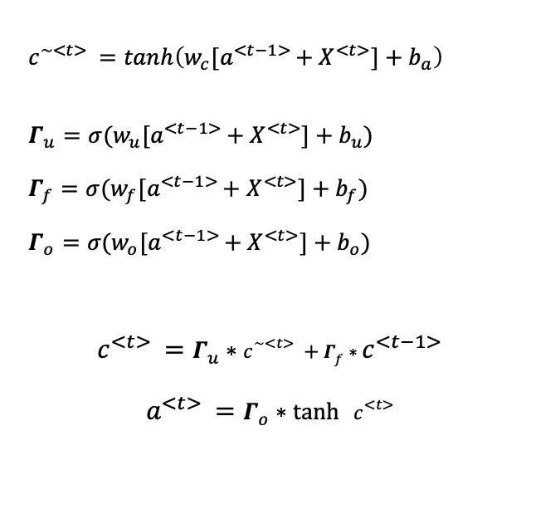
LSTM Architecture
$$c^{\sim <t> }=tanh\left(w_{c}{[a}^{<t−1> }+ X^{<t>}]+b_{a}\right)$$
$$Γ_{u}=σ(w_{u}{[a}^{<t−1> }+ X^{<t>}]+b_{u})$$
$$Γ_{f}=σ(w_{f}{[a}^{<t−1> }+ X^{<t>}]+b_{f})$$
$$Γ_{o}=σ(w_{o}{[a}^{<t−1> }+ X^{<t>}]+b_{o})$$
$$c^{<t> }=Γ_{u}∗c^{\sim <t> }+Γ_{f}∗c^{<t−1> }$$
$$a^{<t> }=Γ_{o}∗\tanh{ }c^{<t> }$$

Slide 14
Bidirectional LSTM
An extended version of basic LSTMs where the trained model is obtained by applying LSTM twice.
Using the bidirectional LSTMs can improve the performance of the model

Slide 15
LSTM Modeling
Training algorithm:
Input: Genome data
Step 1 (Constructing Words).
Step 2 (Constructing Dictionary).
Step 3 (Constructing Batch).
Step 4 (Constructing Epoch (Iteration)).

Slide 16
LSTM Training Modeling

Slide 17
LSTM-based for Sequence Alignment Algorithm
Result: The aligned sequences.
1) Decompose;
2) Feed Sequences to the LSTM Model (Phase 1);
3) Decompose Query Sequences;
4) Feed Sequences to the LSTM Model (Phase 2);
5) Compare Vectors;
6) Find the Best Candidate Vector;

Slide 18
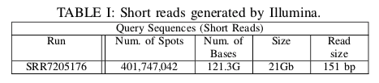
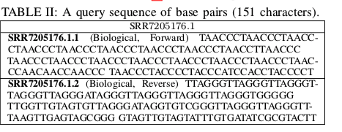
Case Study

Slide 19
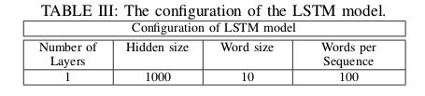
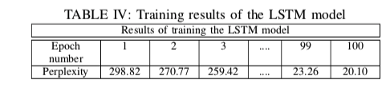
Case Study

Slide 20

Summary
Novel training algorithm using bidirectional LSTM to train the genome dataset.
Results of training: fixed-length vector representation of the reference genome -> Trained model
Trained model can be leveraged to learn LSH
Perform LSH-based sequence alignment
One application: Label which part of DNA corresponds to protein
Case study: Model human Genome which results to 20.10 perplexity
Questions?

